Slide 1



Oluwatobi Akinwumi Sales Opportunity Tracking
View in Power BI
Last data refresh:
6/7/2025 4:59:42 PM UTC
Downloaded at:
6/7/2025 5:07:41 PM UTC

Slide 2
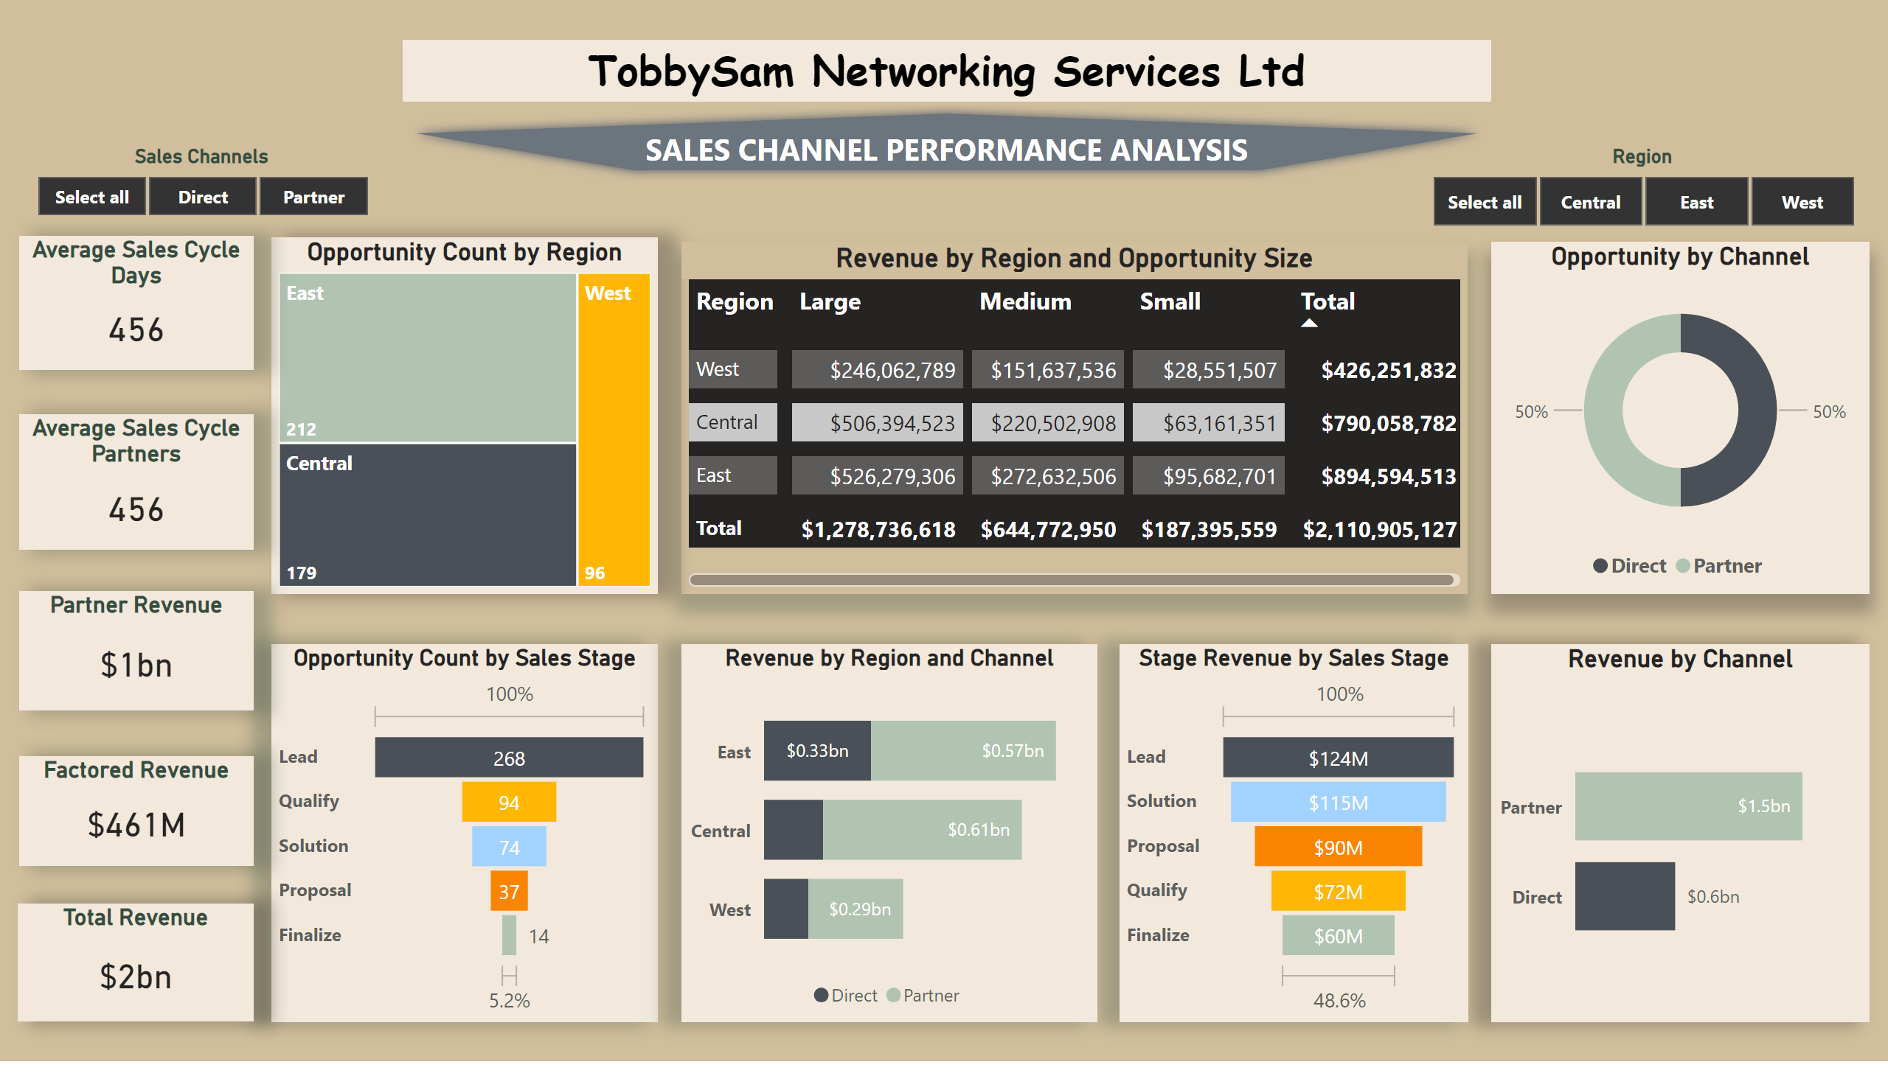
Page 1
Notes:
Revenue by Channel
No alt text provided
Average Sales Cycle Days
No alt text provided
Average Sales Cycle Partners
No alt text provided
Partner Revenue
No alt text provided
Factored Revenue
No alt text provided
Total Revenue
No alt text provided
Opportunity by Channel
No alt text provided
treemap
No alt text provided
funnel
No alt text provided
funnel
No alt text provided
Revenue by Region and Channel
No alt text provided
Revenue by Region and Opportunity Size
No alt text provided
Region
No alt text provided
Sales Channels
No alt text provided
TobbySam Networking Services Ltd
No alt text provided

Slide 3
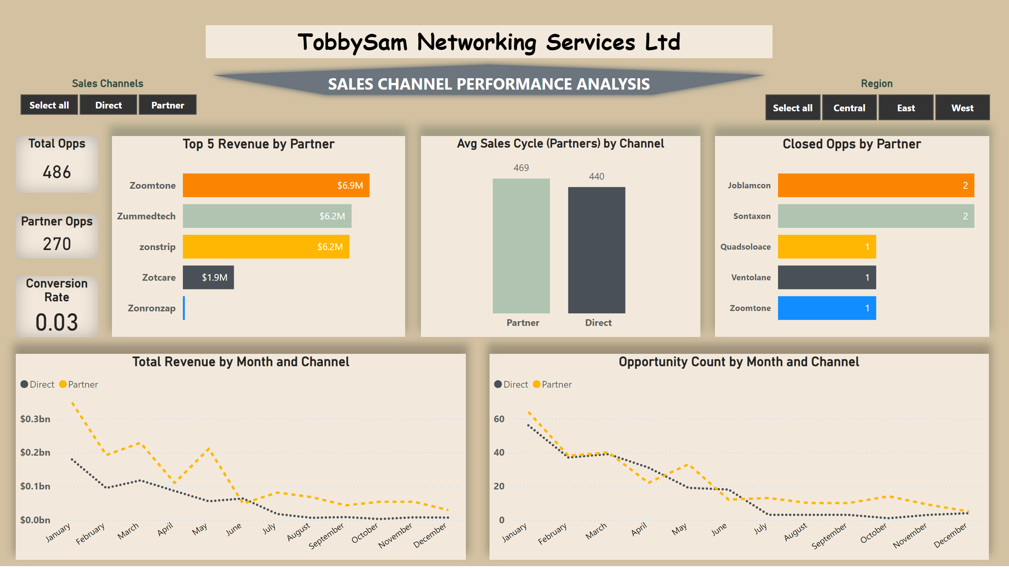
Partner
Notes:
Top 5 Revenue by Partner
No alt text provided
barChart
No alt text provided
lineChart
No alt text provided
lineChart
No alt text provided
columnChart
No alt text provided
Total Opps
No alt text provided
Conversion Rate
No alt text provided
Partner Opps
No alt text provided
TobbySam Networking Services Ltd
No alt text provided
Sales Channels
No alt text provided
Region
No alt text provided

